Slide 1
Procedures Final Classification

Slide 2
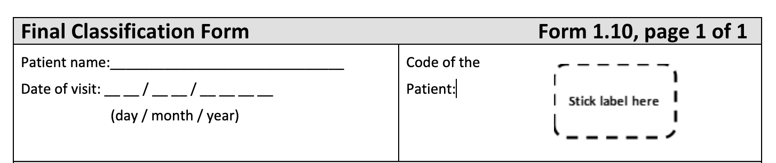
Final Classification Form
Each time a child leaves the study, the supervisor completes the Final Classification Form

Slide 3
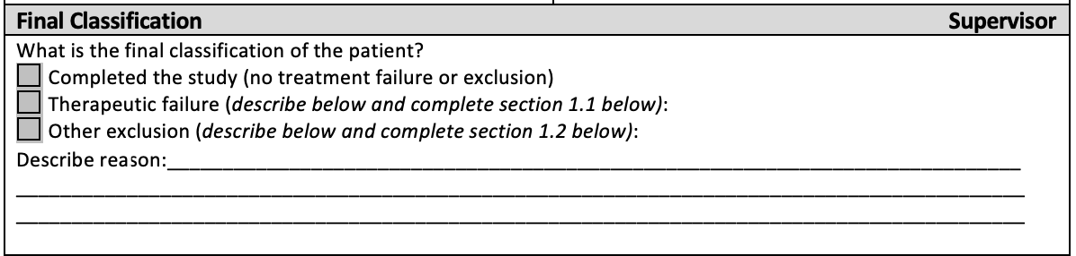
3 Classifications
Complete the study without exclusion
Exclusion due to therapeutic failure
Exclusion for another reason

Slide 4
Therapeutic Failure
Early
Late
DAYS | 0 | 1 | 2 | 3 | 7 | 14 | 21 | 28 | 35 | 42 | Extra Day
Parasitemia must always be present!

Slide 5
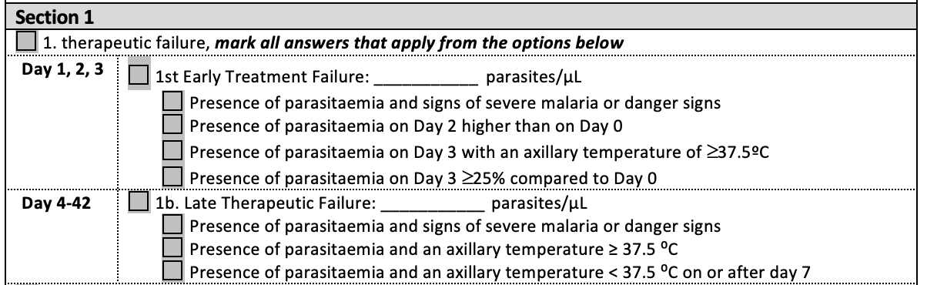
1. Therapeutic Failure
Notes:
1a not first*** fix on form

Slide 6
1. Therapeutic Failure

Slide 7
Early Treatment Failure

Slide 8
Calculation of Percentage of Parasitemia Reduction
Is this value greater than or equal to 25%?
If Yes, Early Treatment Failure
Parasitemia D3:
x 100 = %
Parasitemia D0:

Slide 9
Calculation of Percentage of Parasitemia Reduction
Is this value greater than or equal to 25%?
If Yes, Early Treatment Failure
Parasitemia D3:
x 100 = %
Parasitemia D0:
50000
50
100000

Slide 10
Patient with:
Parasitemia D0 of 20,000
Parasitemia D3 of 100,000
Do they have Early Treatment Failure?

Slide 11
Example:
Parasitaemia D0 of 100,000
Parasitaemia D3 of 20,000
Calculation of Percentage of Parasitemia Reduction
Is this value greater than or equal to 25%?
No, not Early Treatment Failure
Parasitemia D3:
x 100 = %
Parasitemia D0:
20.000
20
100.000

Slide 12
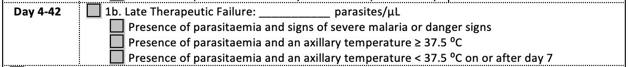
1b. Late Therapeutic Failure

Slide 13
1b. Late Therapeutic Failure
Attn: If the child is on days 4, 5 or 6 and has parasitaemia with no danger signs or fever it is NOT Late Therapeutic Failure!

Slide 14
1b. Late Therapeutic Failure
Any parasitemia
with or without fever
Early
DAYS | 0 | 1 | 2 | 3 | 7 | 14 | 21 | 28 | 35 | 42 | Extra Day
D4, D5, D6
Only parasitaemia with fever (≥37.5)

Slide 15
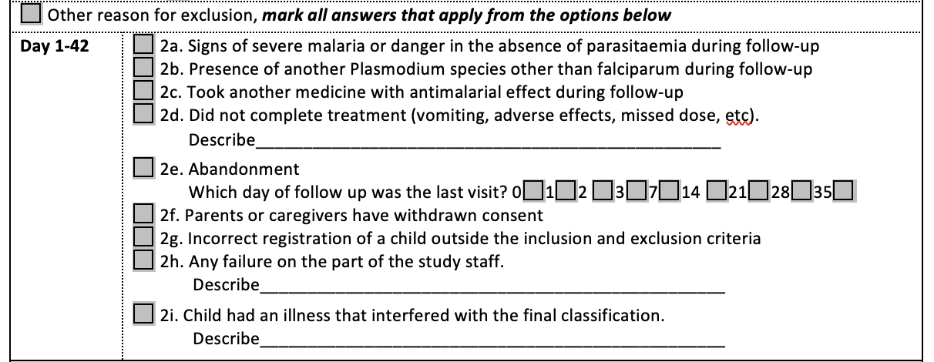
2. Other reasons for exclusion

Slide 23
Referral
In the following cases, the child should be referred:
therapeutic failure
any sign of danger or serious malfunction
adverse effects of treatment
presence of another Plasmodium species.

Slide 24
Referral

Slide 25
Examples
Day 14
Parasitemia 0
Haemoglobin 4.5

Slide 26
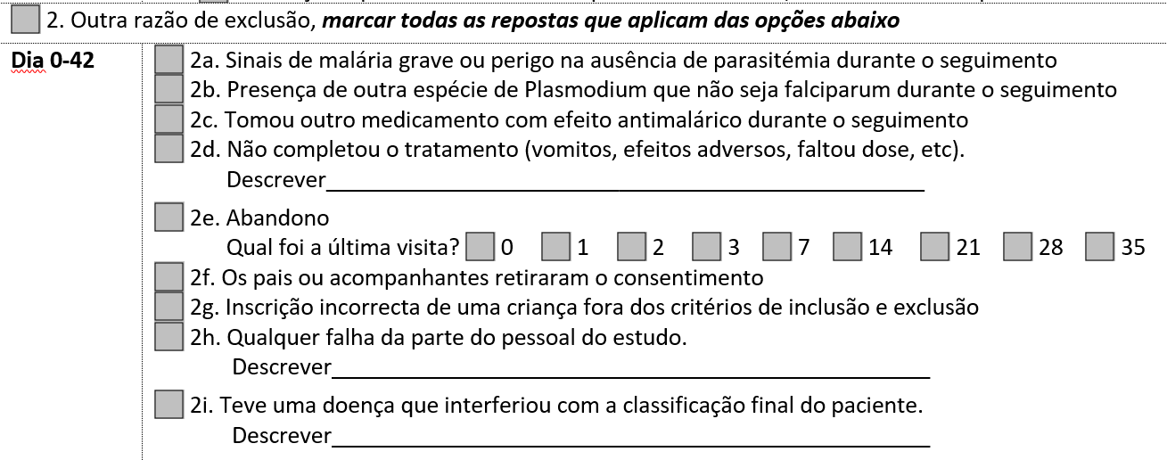
Examples
Day 14
Parasitemia 0
Haemoglobin 4.5 (Anaemia=Danger sign)
Excluded, another reason:
Notes:
*fix the screenshot

Slide 27
Examples
Day 7
Parasitemia faliciparum 200
Haemoglobin 11
Temperature 36.9

Slide 28
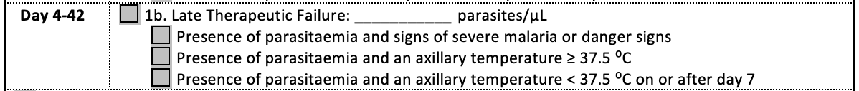
Examples
Day 7
Parasitemia falciparum 200 (Parasitemia on or after day 7)
Haemoglobin 11
Temperature 36.9
Excluded, Late Therapeutic Failure:

Slide 29
Example
Day 3
Parasitemia falciparum 10,000
Temperature 36.9
Parasitemia Day 0: 20.000

Slide 30
Example
Day 3
Parasitemia 10,000
Temperature 36.9
Parasitemia Day 0: 20.000
Parasitemia D3/Parasitemia D0 * 100
10.000/50.000 * 100 = 50%

Slide 31
Example
Day 3
Parasitemia 10,000
Temperature 36.9
Parasitemia Day 0: 20.000
Excluded, Early Therapeutic Failure:

Slide 32
Example
Day 1: Child returns, cannot sit or stand
Parasitaemia: 0

Slide 33
Example
Day 1: Child returns, cannot sit or stand
Parasitaemia: 0
Excluded, another reason:

Slide 34
Example
38,1C
Parasitemia 0
Day 7

Slide 35
Example
38,1C
Parasitemia 0
Day 7
DEPENDS
Not excluded, continues in the study
or

Slide 36
Example
37,0C
Parasitemia 100
Day 4

Slide 37
Example
37,0C
Parasitemia 100
Day 4
Not excluded, continue in the study!

Slide 38
Example
37,0C
Parasitemia 4000
Day 14

Slide 39
Example
37,0C
Parasitemia 4000
Day 14
Excluded, Late Therapeutic Failure:

Slide 40
Why PCR?
Two ways to get infection again during the follow-up period:
Recrudescence (the original infection)
Reinfection

Slide 41
Reclassification of Late Therapeutic Failures
Recrudescence (true therapeutic failure)
Therapeutic failure of the original infection
Parasite on day of failure of the same genotype as the genotype of the parasite on day 0
Reinfection
Infection with another parasite during the follow-up period
Parasites on day 0 and on day of failure with different genotypes
Notes:
There are two possible explanations for the presence of parasites during follow-up.
Firstly the participants could have experienced a true treatment failure, called a recrudescence, in which the parasite causing the original infection is not adequately cleared during the three-day treatment.
In this case, the parasites on day 0 and day of failure are genetically indistinguishable.
Alternately, the patient could have acquired a second infection, referred to as a reinfection, during the follow-up phase. In this case the parasites on day 0 and day of treatment failure would be genetically different.
In this last case, one cannot assess the response to treatment.

Slide 42
Therapeutic Efficacy - ASAQ

Slide 43
Resistance Markers
Lumefantrine:
pfmdr1
Artemisinin:
K13

